Slide 1
User Analytics in the Telecom Industry
By: Garima Mahajan

Slide 2
Project Overview
Data cleaning and preprocessing was performed on Dataset.
The different methods employed for data wrangling were:
- Filling the null values in column
- Checked the datatypes, summary and dimensions of the dataset, treated the missing values
Task 1 - User Overview Analysis was performed and examined user behavior, device preferences, and data usage patterns to identify trends across applications like Social Media, YouTube, and Netflix.
Task 2 - User Engagement Analysis was performed and it involved clustering users based on engagement metrics and identifying top users across various applications.
Task 3 - User Experience Analysis involved assessing user experience by analyzing network performance metrics such as TCP retransmissions, Round Trip Time (RTT), and throughput. Additionally, device characteristics were considered, and users were clustered based on their experience scores.
Task 4 involved calculating engagement and experience scores for each user, predicting satisfaction using regression, and clustering users based on their scores using k-means.

Slide 3
Methodology
Libraries used:
Pandas: Data manipulation library that provides data structures like DataFrames for easy handling and analysis of structured data.
NumPy: Fundamental library for numerical computing in Python, offering powerful array objects and mathematical functions for array operations.
Matplotlib: Comprehensive plotting library for creating static, interactive, and publication-quality visualizations in Python.
Seaborn: Statistical data visualization library that works well with Pandas and Matplotlib, offering high-level functions for creating informative statistical plots.
SimpleImputer: Was used to fill in (impute) missing values in your dataset
StandardScaler: Was used to standardizes features by removing the mean and scaling to unit variance
The code was executed in Google Colab notebook.

Slide 4
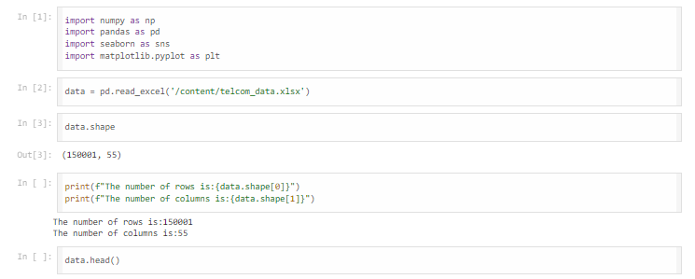
Solution
Importing the libraries
To read the excel file
To check dimension of the dataset
To check for the rows and columns in the columns
To get first 5 rows of the dataset

Slide 5

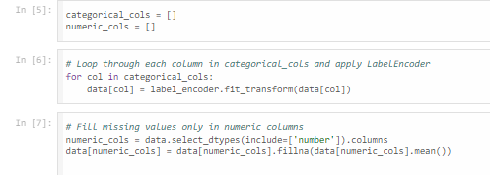
Solution
To get the information of the columns in dataset
To get the number of null values in the dataset
For label encoding the categorical cols

Slide 6
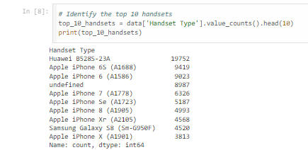
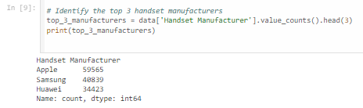
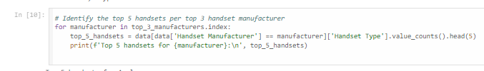
Solution
To identify the top 10 handsets from the Handset Types
To identify the top 3 handset manufacturers
To identify the top 5 handsets per top 3 handset manufacturer

Slide 7
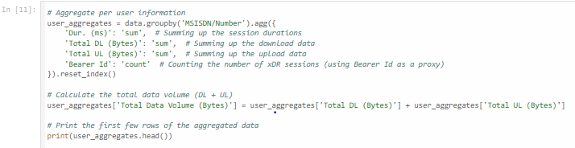

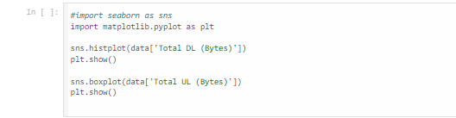
Solution
To group user data by MSISDN and aggregate on top of session duration, upload and download data
To compute the basic metrics
To plot the upload and download data

Slide 8

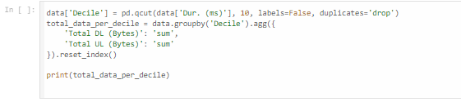
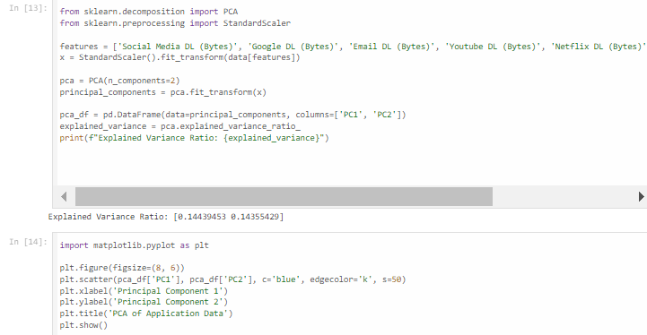
Solution
To plot the scatterplot for Youtube Data vs Total Data
To divide the data into deciles and check % of data in each decile
To perform PCA on the download data

Slide 9
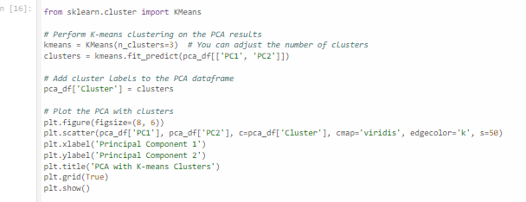
Solution
To perform K-means clustering on the principal components derived from PCA and visualize the clusters
The high skew columns were normalized using logarithmic transformation

Slide 10
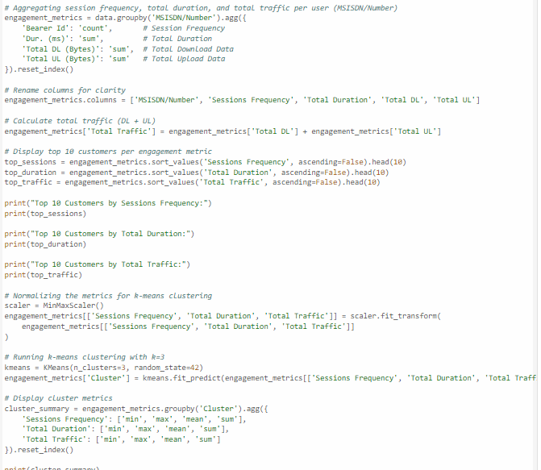
Solution
To aggregate the engagement metrics and display top 10 users by Engagement Metrics
To normalize the metrics using minmax scaler

Slide 11
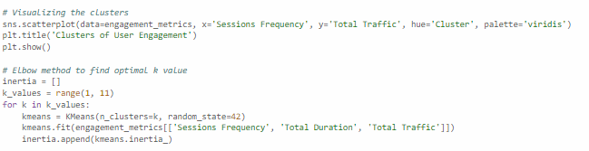
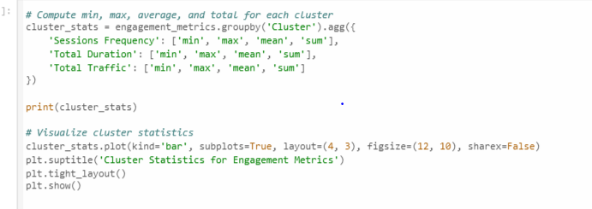
Solution
To visualize the clusters and find optimal k using Elbow method
To compute the minimum, maximum, mean, and sum for each cluster in terms of session frequency, total duration, and total traffic.

Slide 12
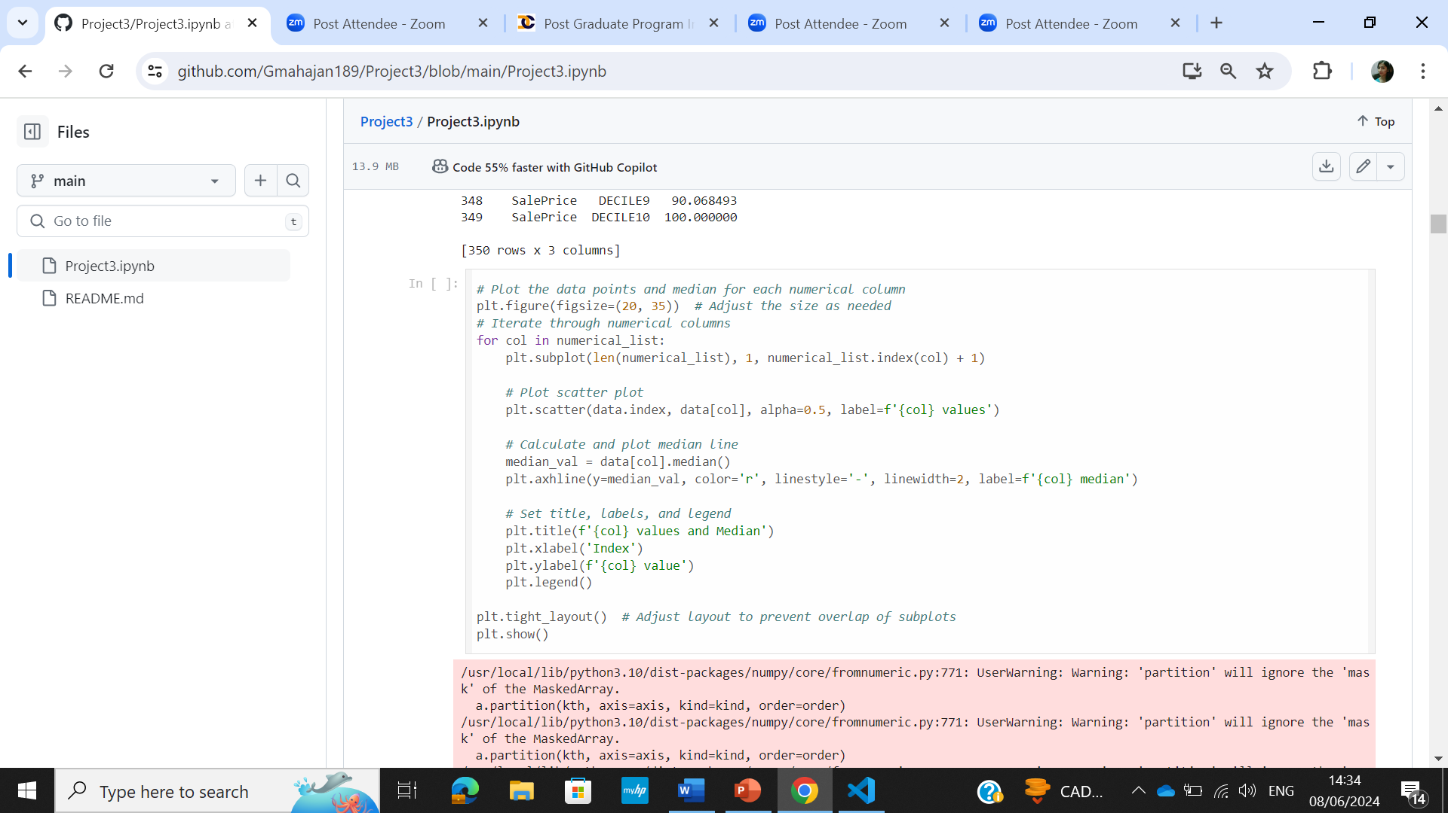
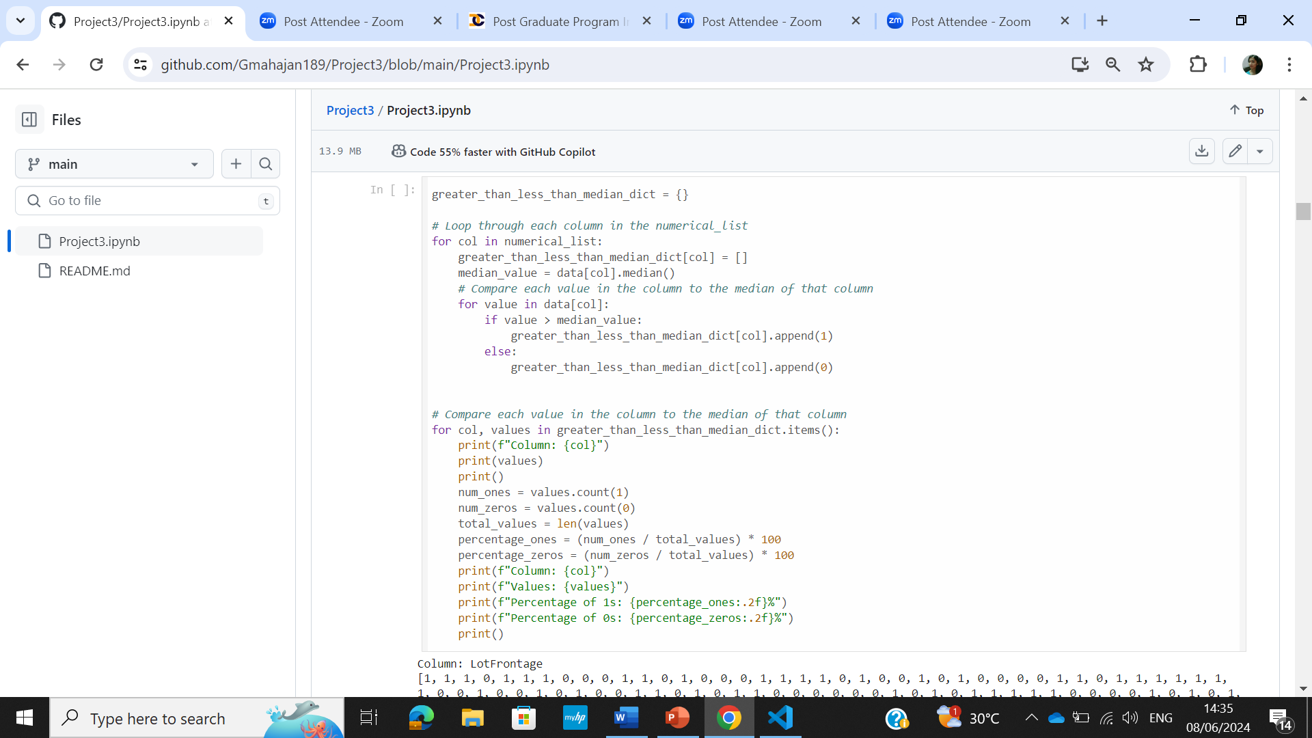
Solution
Data distribution for each column along the median was plotted using scatter plot
Dictionary was made and the percentage data greater than,less than median was stored

Slide 13
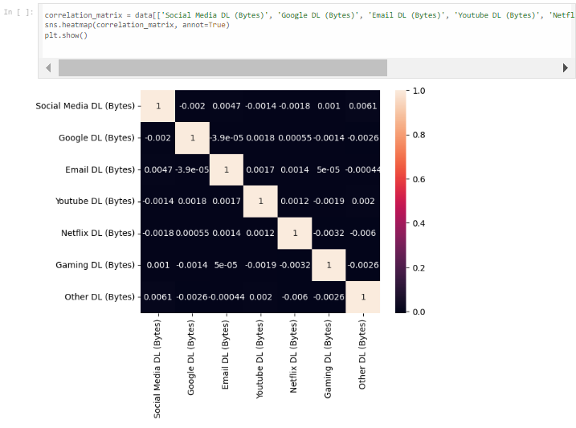
Solution
To calculate the correlation matrix for the selected columns and create heatmap to visualize the correlation

Slide 14
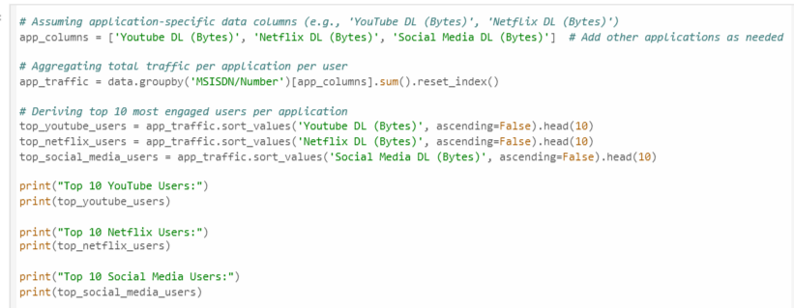
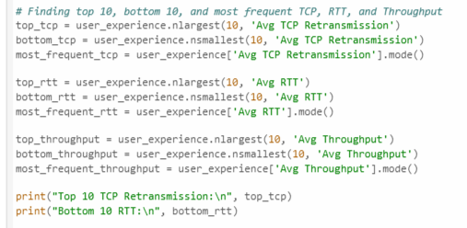
Solution
To derive the top 10 youtube,Netflix and social media users based on the download data
To identify the top 10, bottom 10, and most frequent values for the metrics: TCP retransmission, RTT, and throughput.

Slide 15
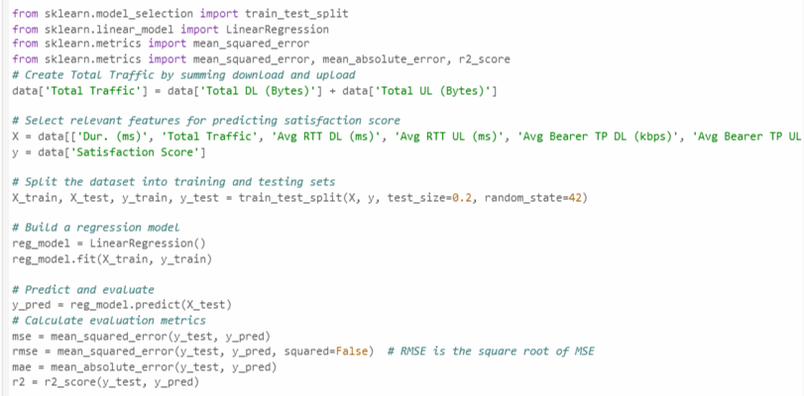
Solution
To build a linear regression model to predict customer satisfaction scores based on various network parameters and traffic metrics
To calculate multiple evaluation metrics such as MSE, RMSE, MAE, and R²

Slide 16
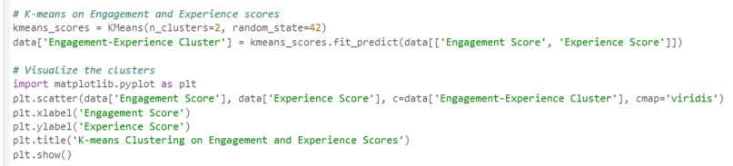
Solution
To perform K-means clustering on the engagement and experience scores, and visualize the clusters using a scatter plot
EDA plots were made for the significant categorical variables

Slide 17
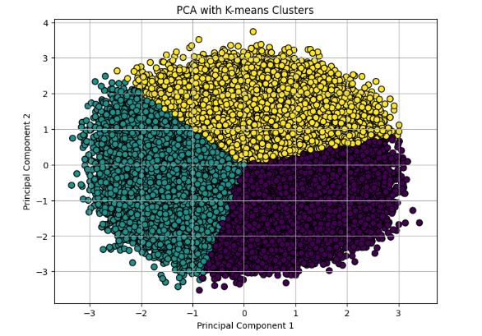
EDA Plots and Conclusion
The PCA plot shows the distribution of users based on the first two principal components (PC1 and PC2), which represent the most significant patterns in the application data usage. The k-means clustering identifies different groups of users with similar data consumption behaviors.
PC1:
Differentiates between users who primarily use Netflix (positive values) and those who use Social Media and Other applications (negative values).
PC2:
Separates users based on Gaming (positive values) versus YouTube (negative values) data usage.
In the plot, the clusters likely group users with dominant behaviors, such as high Netflix users, high Gaming users, or high YouTube users, providing insights into how different groups consume application data.

Slide 18
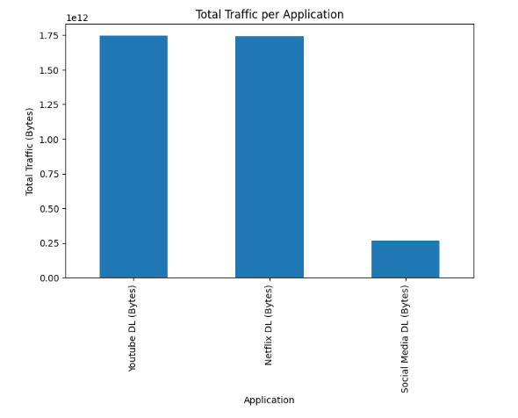
EDA Plots and Conclusion
The chart indicates that both YouTube and Netflix generate significantly higher download traffic compared to Social Media.
The volume of data consumed through YouTube and Netflix is almost equal, highlighting their heavy use for video streaming.
In contrast, Social Media traffic is noticeably lower, suggesting that users are downloading much less data on these platforms, likely due to the smaller file sizes of content like posts and images compared to video streams.

Slide 19
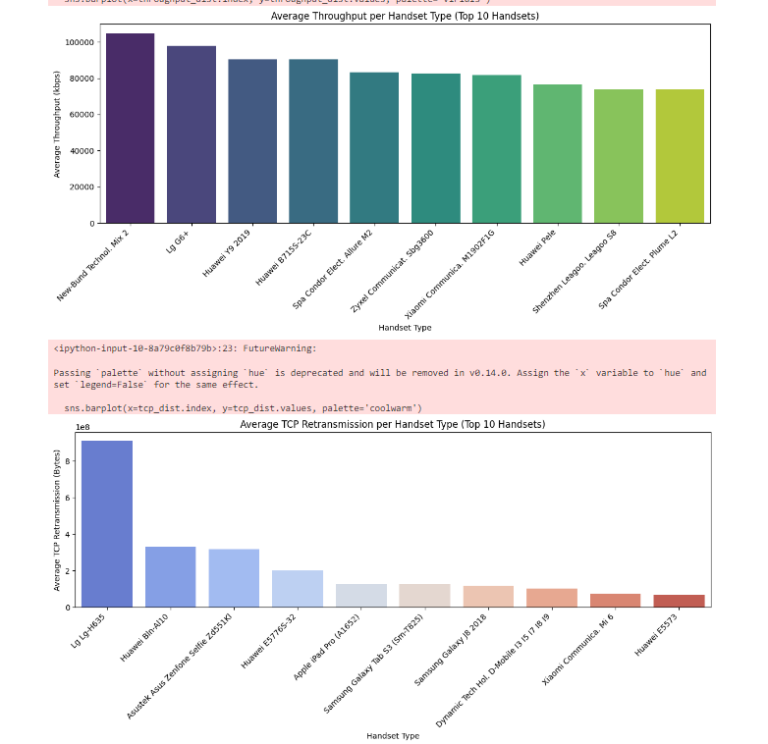
EDA Plots and Conclusion
Average Throughput per Handset Type (Top 10 Handsets):
This chart displays the top 10 handsets by average throughput in kbps. The highest throughput is seen for the "New Apple iPhone" model.
Average TCP Retransmission per Handset Type (Top 10 Handsets):
This chart shows the top 10 handsets with the highest average TCP retransmissions. The "LG + H815" model appears to have the highest retransmission values.

Slide 20
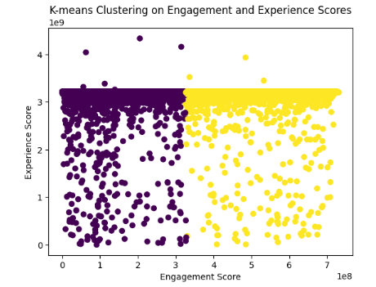
EDA Plots and Conclusion
The clustering shows a clear segmentation of users based on engagement. Those with high engagement tend to group together, while low-engaged users form their own group.
The experience scores for both clusters are very close, indicating that both groups may have similar levels of user experience.
The engagement scores, though different, are not drastically apart, showing that both clusters contain users who are fairly engaged, but those in Cluster 1 are slightly more engaged.
This could help identify users in Cluster 0 who, while having a good experience, may benefit from further efforts to increase their engagement. Conversely, Cluster 1 contains users who are already well-engaged, and maintaining their experience level might be key.

Slide 21
THANK YOU!

